Slide 1
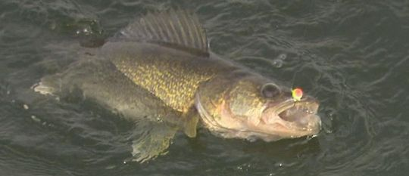
Factors Affecting Fish Condition
Targets for Reducing Stress from Catch and Release
Christopher Somers
University of Regina, June 2015

Slide 2
1. Metabolic Stress
Exhaustion
Capture and handling
Release site conditions
Heat
Livewell temperature
Air temperature during weighing
Low Oxygen
Livewell conditions (temperature, aeration)
Weighing

Slide 3
Stress - Key Points
Exhaustion
Angler technique (playing time, handling)
Distance from release point to suitable habitat
Heat
Warm lake water in live wells (25⁰C and up lethal)
Hot sun on bins and recovery tanks
Low Oxygen
Livewells not run sufficiently
High temperature correlated with low oxygen

Slide 4
Interventions – Metabolic Stress
Ice blocks in livewell to reduce temperature.
Run livewells continuously or on cycle timer.
Reduce time in livewell – multiple weigh-ins.
Minimize time spent in weigh tubs.

Slide 5
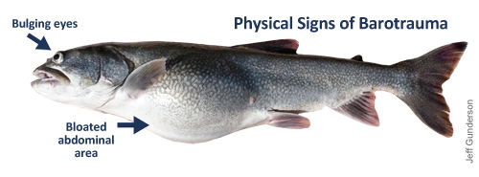
2. Barotrauma (similar to the “bends”)
Expanded gas in tissues due to rapid decompression as fish is brought to surface.
Symptoms:
Bloated, distended belly (swim bladder), inability to submerge
Pop-eyes
Stomach distended through mouth
Lack of vigor, death

Slide 6
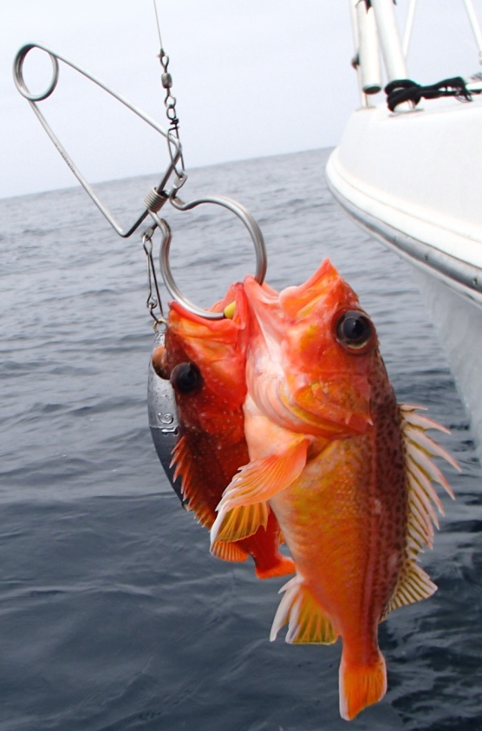
Barotrauma - Key Points
Depth of capture
Angling below depths of ~20 feet is when risk increases.
Contributing Factors:
Time of year, water temperature
Oxygen levels in water

Slide 7
Interventions – Barotrauma
Restricted angling depths – limit tournament to depths < 30 feet (difficult to enforce).
Alternate tournament dates – cooler water temperature.
Descending devices – safely return fish to depth with neutral buoyancy when they can’t submerge.
Reduce time in livewell – multiple weigh-ins; dedicated release team with descending devices.
Venting or “fizzing” – dangerous techniques that are highly discouraged for walleye.

Slide 8
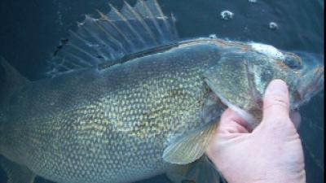
3. Physical Trauma
Hooking / landing injuries.
Damage to gills or other tissue near hook site.
Deep hook placement (gut-hooked).
Abrasions and contusions from netting and transfer to livewell.
Livewell injuries
Physical trauma from boat movement (prominent during rough water conditions).

Slide 9
Physical Trauma - Key Points
Type of tackle / equipment used
Live bait vs. artificial lures
Barbed vs. barbless hooks
Rubber coated nets, weigh cradles, professional handling.
Water conditions / weather
High winds = big waves, fish sloshed around in livewell

Slide 10
Interventions – Physical Trauma
Use of barbless /circle hooks/reduced gangs – specialized tackle to reduce fish injury. Single treble gang on crankbaits.
Use of coated landing nets and weigh cradles – special designs to reduce abrasions and gill injuries.
Reduce time in livewell – multiple weigh-ins, reduce time spent in rough conditions.

Slide 11
Current Targets
(Things that can be worked on right right now)

Slide 12
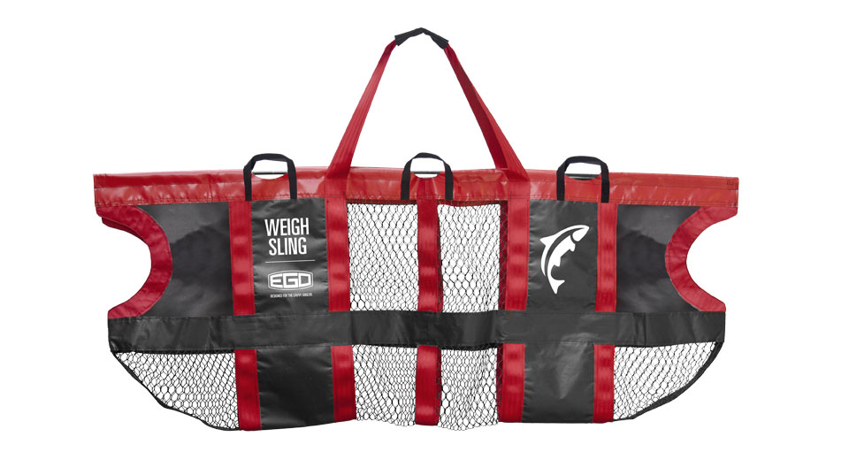
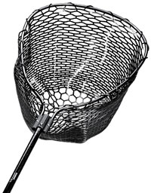
Main Focus 1: Angler Techniques

Slide 13
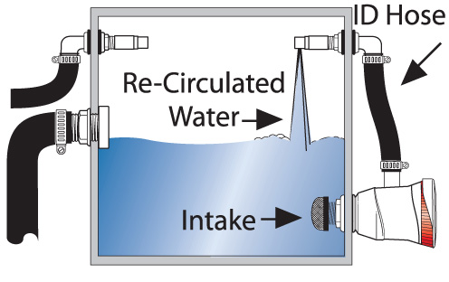
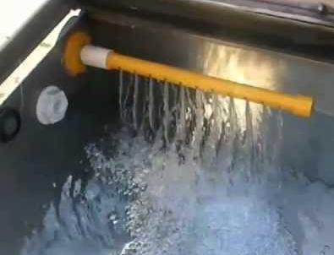
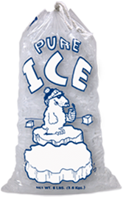
Main Focus 2: Livewell Operation
MAX

Slide 14
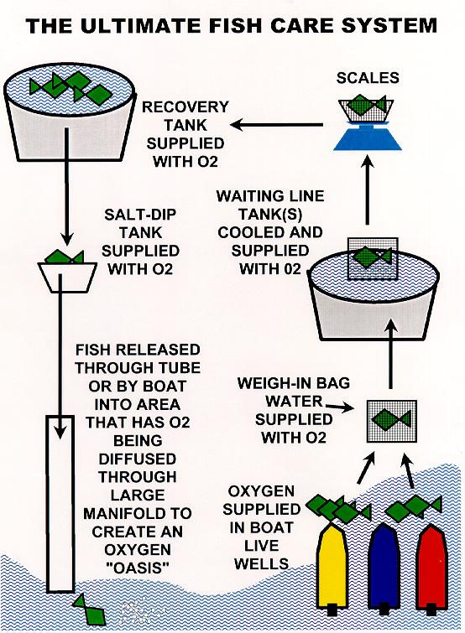
Main Focus 3: Weigh Station
IDEAL
REALITY
Minimize distance from livewells to scale.
Avoid line-ups at scale with fish in dry tubs.
Multiple weigh-ins to reduce time in livewells.

